Slide 1
Informed search

Slide 2
Module
Uninformed search
Continue from last lecture, we will look upon another strategy of uninformed search:
Bidirectional search
Discussion consists:
Algorithm
Time and space complexities

Slide 3
Informed Search
A*
Greedy search
Uniform cost search

Slide 4
Search Strategies
Blind search
Breadth first search
Depth first search
Iterative deepening search
Bidirectional search
Informed search
Constraint satisfaction
Adversary search

Slide 5
Search Graphs
If the search space is not a tree, but a graph, the search tree may contain different nodes corresponding to the same state.

Slide 6
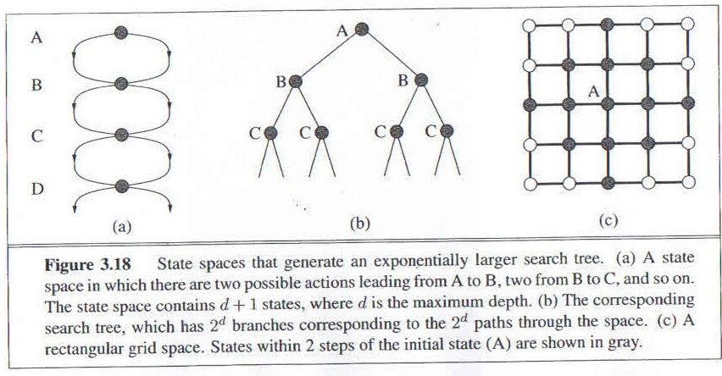
A State Space that Generates an Exponentially Growing Search Space

Slide 7
Avoiding Repeated States
In increasing order of effectiveness in reducing size of state space and with increasing computational costs:
Do not return to the state you just came from.
Do not create paths with cycles in them.
Do not generate any state that was ever created before.
Net effect depends on frequency of “loops” in state space.

Slide 8
Graph Search Algorithm
Let fringe be a list containing the initial state
Let closed be initially empty
Loop
if fringe is empty
return failure
Node remove-first (fringe)
if Node is a goal
then return the path from initial state to Node
else put Node in closed
generate all successors of Node S for all nodes m in S
if m is not in fringe or closed
merge m into fringe
End Loop

Slide 9
Uniform Cost Search (UCS)
Enqueue nodes by path cost.
Let g(n)=cost of the path from the start node to the current node n. Sort nodes by increasing value of g.
Expand lowest cost node of the fringe.
Complete
Optimal/admissible
Exponential time and space complexity. O(b^{d})

Slide 10
Example
Which path will the UCS strategy will find, in a way to get to the goal state?
S
1
18
5
A
B
C
5
12
5
G

Slide 11
Informed Search
We have seen that uninformed search methods that systematically explore the state space and find the goal.
Inefficient in most cases.
Informed search methods use problem specific knowledge, are more efficient.

Slide 12
Heuristics
Heuristic: “rule of thumb”
“Heuristics are criteria, methods or principles for deciding which among several alternative courses of action promises to be the most effective in order to achieve some goal.” – Judea Pearl
Can use heuristics to identify the most promising search path.

Slide 13
Example of Heuristic Function
A heuristic function at a node n is an estimate of the optimum cost from the current node to a goal. Denoted by h(n).
h(n) = estimated cost of the cheapest path from node n to a goal node.

Slide 14
Heuristics Example
8-puzzle: Number of tiles out of place
2 | 8 | 3
1 | 6 | 4
 | 7 | 5
1 | 2 | 3
8 |  | 4
7 | 6 | 5

Slide 15
Heuristics Example
8-puzzle: Manhattan distance (distance tile is out of place)
2 | 8 | 3
1 | 6 | 4
 | 7 | 5
1 | 2 | 3
8 |  | 4
7 | 6 | 5

Slide 16
Best First Search
Generalization of breadth first search.
Priority queue of nodes to be explored.
Cost function f(n) applied to each node.

Slide 17
Best First Search
Let fringe be a priority queue containing the initial state
Loop
if fringe is empty return failure
Node remove-first (fringe)
if Node is a goal
then return the path from initial state to Node
else generate all successors of Node, and
Put the newly generated nodes into fringe according to their f values
End Loop

Slide 18
Greedy Search
Idea: Expand node with the smallest estimated cost to reach the goal
Use heuristic function f(n)=h(n)
Not optimal
Incomplete

Slide 19
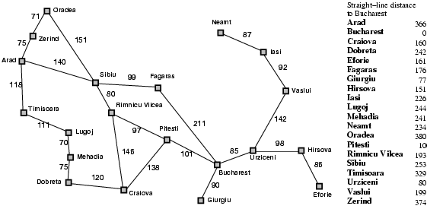
Example of Greedy Best-First Search

Slide 20

GBFS Strategy

Slide 21
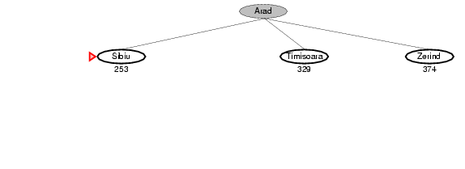
GBFS Strategy

Slide 22
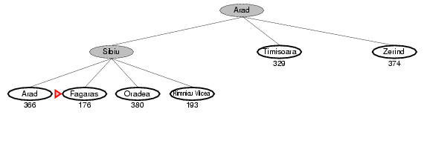
GBFS Strategy

Slide 23
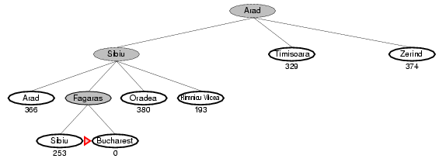
GBFS Strategy

Slide 24
Properties of GBFS
Complete? No – can get stuck in loops, e.g., Iasi → Neamt → Iasi → Neamt →
Time? O(b^{m}), but a good heuristic can give dramatic improvement
Space? O(b^{m}) -- keeps all nodes in memory
Optimal? No

Slide 25
A* Search
Hart, Nilsson & Rafael, 1968
Best first search with f(n) = g(n) + h(n)
Where g(n)=sum of edge costs from start to n
h(n)=estimate of lowest cost path n→ goal
If h(n) is admissible then search will find optimal solution
Underestimates cost of any solution which can reach from node

Slide 26
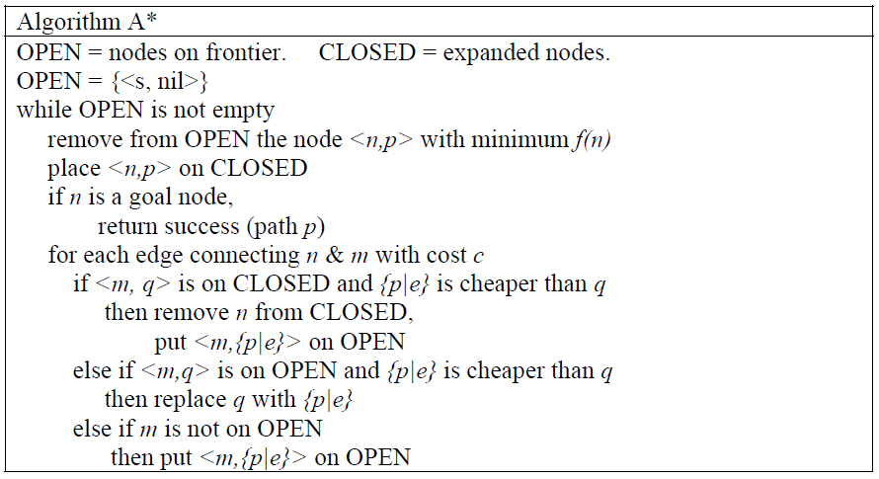
A* Algorithm

Slide 27
A* Search Analysis
Optimal-optimally efficient
Complete
Number of nodes search still exponential in the worst case

Slide 28
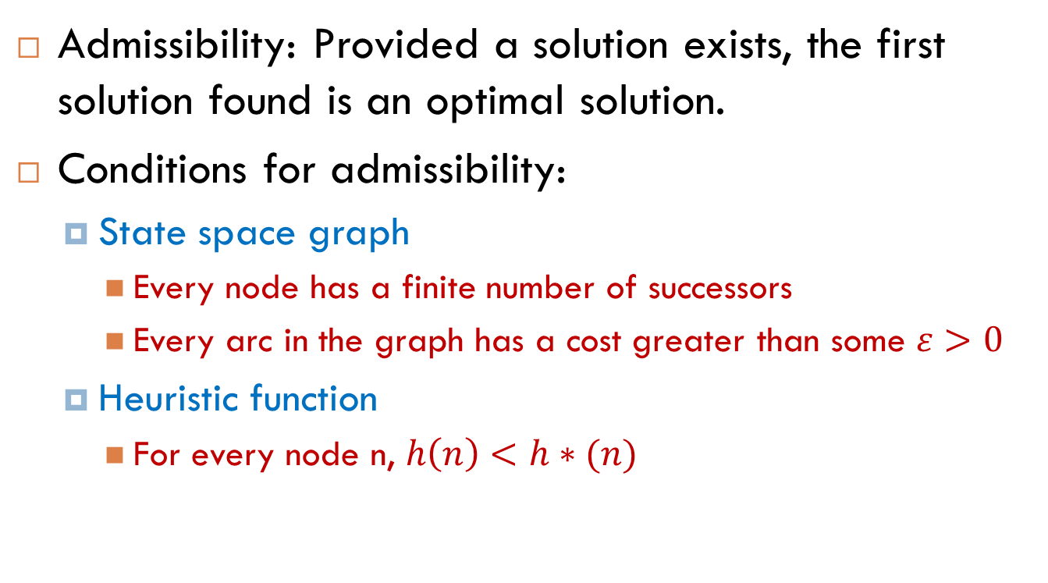
Admissibility of A*
Admissibility: Provided a solution exists, the first solution found is an optimal solution.
Conditions for admissibility:
State space graph
Every node has a finite number of successors
Every arc in the graph has a cost greater than some $ε>0$
Heuristic function
For every node n, $h\left(n\right)<h∗(n)$

Slide 29
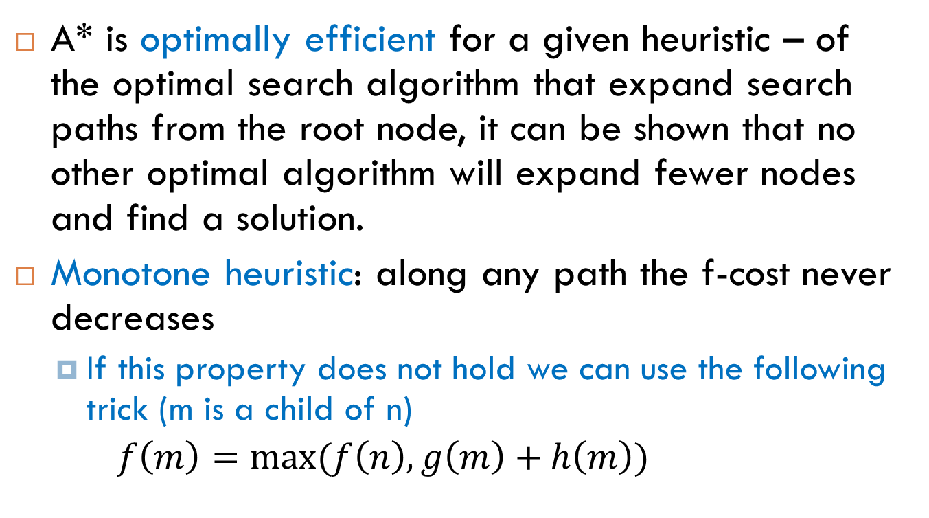
Admissibility of A*
A* is optimally efficient for a given heuristic – of the optimal search algorithm that expand search paths from the root node, it can be shown that no other optimal algorithm will expand fewer nodes and find a solution.
Monotone heuristic: along any path the f-cost never decreases
If this property does not hold we can use the following trick (m is a child of n)
$f\left(m\right)=max⁡(f\left(n\right), g\left(m\right)+h\left(m\right))$

Slide 30
Proof of the Optimality of A*
Let G be an optimal goal state
f* is the optimal path cost
G2 is a suboptimal goal state: gG(2)>f*
Suppose A* has selected G2 from OPEN for expansion.

Slide 31
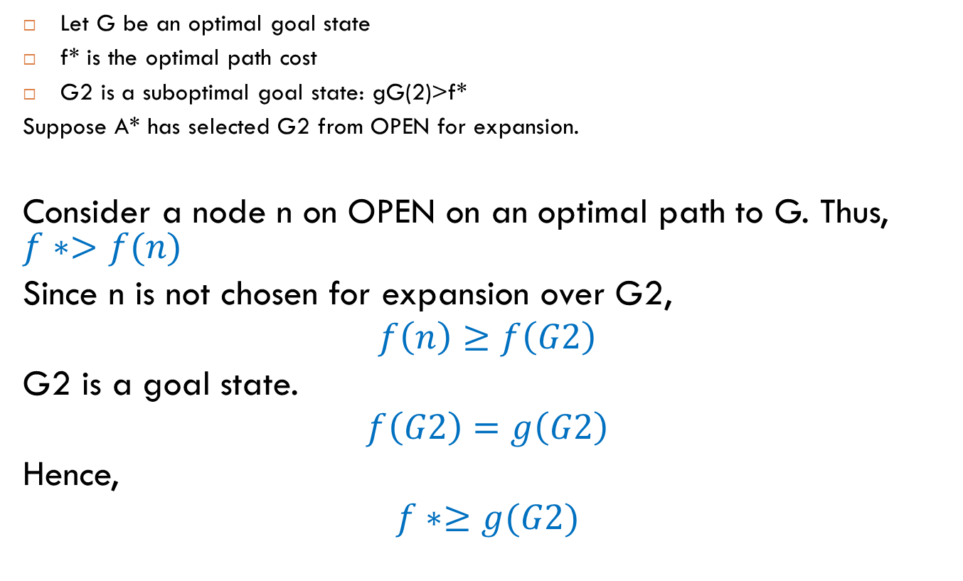
Proof of the Optimality of A*
Let G be an optimal goal state
f* is the optimal path cost
G2 is a suboptimal goal state: gG(2)>f*
Suppose A* has selected G2 from OPEN for expansion.
Consider a node n on OPEN on an optimal path to G. Thus, $f∗>f(n)$
Since n is not chosen for expansion over G2,
$$f\left(n\right)≥f\left(G2\right)$$
G2 is a goal state.
$$f\left(G2\right)=g\left(G2\right)$$
Hence,
$$f∗≥g(G2)$$

Slide 32
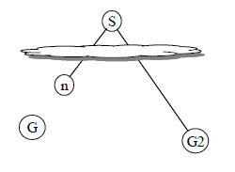
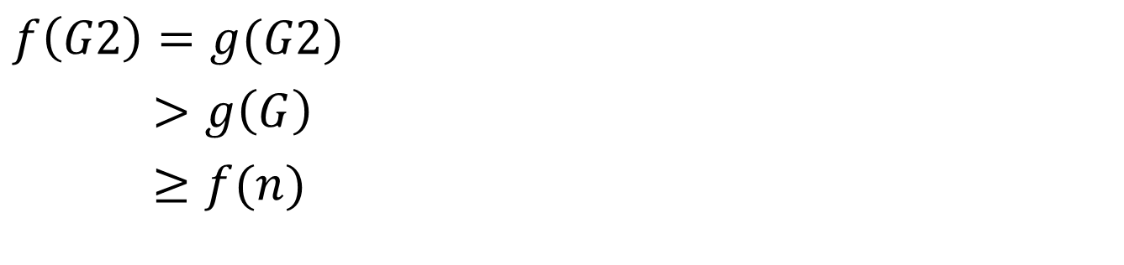

Slide 33
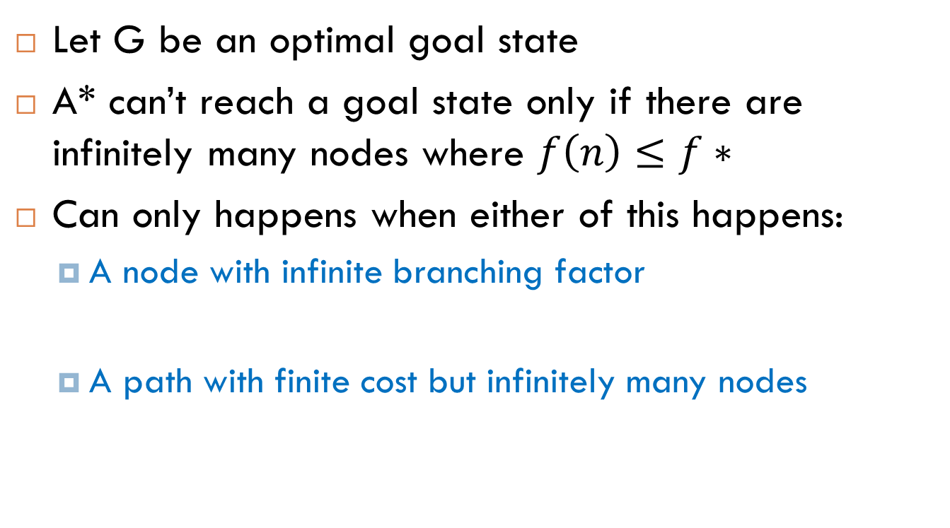
Completeness of A*
Let G be an optimal goal state
A* can’t reach a goal state only if there are infinitely many nodes where $f\left(n\right)≤f∗$
Can only happens when either of this happens:
A node with infinite branching factor
A path with finite cost but infinitely many nodes

Slide 34
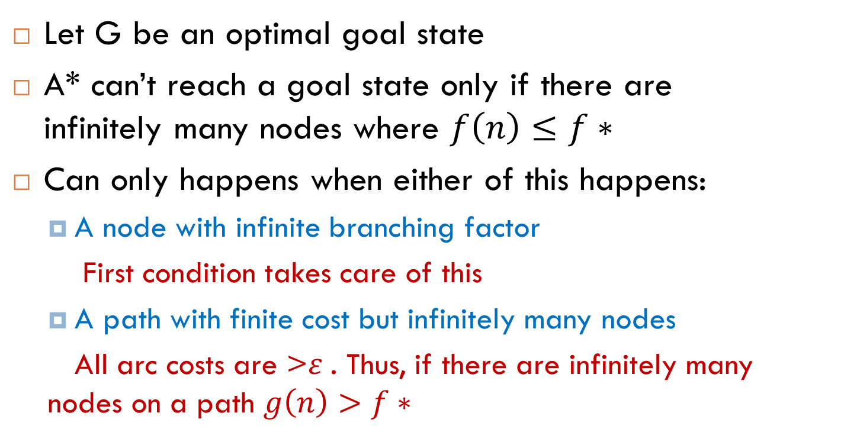
Completeness of A*
Let G be an optimal goal state
A* can’t reach a goal state only if there are infinitely many nodes where $f\left(n\right)≤f∗$
Can only happens when either of this happens:
A node with infinite branching factor
First condition takes care of this
A path with finite cost but infinitely many nodes
All arc costs are >$ε$. Thus, if there are infinitely many nodes on a path $g\left(n\right)>f∗$

Slide 35
Study this map of Romania. Note the distances between cities and try and calculate the shortest route between Arad and Bucharest. Then press space to see the optimal route marked in red.
The optimal route between the two cities takes us through Sibiu, Rimnicu and Pitesti. Press space to continue with the slideshow.
71
Oradea
87
Iasi
75
151
Arad
92
Optimal route is (140+80+97+101) = 418 miles
140
140
118
Vaslui
Sibiu
99
Sibiu
Faragas
Timisoara
142
80
111
80
Lugoj
Rimnicu
211
Rimnicu
98
Urziceni
Hirsova
70
97
86
97
Pitesti
Pitesti
Mehadia
146
101
101
Bucharest
86
75
138
Dobreta
90
120
Craiova
Eforie
Giurgui

Slide 36
A* in action
Having established the optimal path between the two towns of Arad and Bucharest we can now test the efficiency of the A* search pattern in finding the same goal state.
Remember that the A* search pattern is the union of two evaluation functions. In the following demonstration the A* search pattern evaluates the cost of the path so far (UCS), together with an admissible heuristic function based on the shortest line distance (SLD) between between the initial state and the goal location, such that
hSLD(n) = straight line distance between n and the goal location.
The following is table of the straight line distances between some of the major Romanian cities and and the goal state, Bucharest.

Slide 37
Straight Line Distances to Bucharest
Town | SLD
Arad | 366
Bucharest | 0
Craiova | 160
Dobreta | 242
Eforie | 161
Fagaras | 178
Giurgiu | 77
Hirsova | 151
Iasi | 226
Lugoj | 244
Town | SLD
Mehadai | 241
Neamt | 234
Oradea | 380
Pitesti | 98
Rimnicu | 193
Sibiu | 253
Timisoara | 329
Urziceni | 80
Vaslui | 199
Zerind | 374
We can use straight line distances as an admissible heuristic as they will never overestimate the cost to the goal. This is because there is no shorter distance between two cities than the straight line distance. Press space to continue with the slideshow.

Slide 38
Once Arad is expanded we look for the node with the lowest cost. Sibiu has the lowest value for f. (The cost to reach Sibiu from Arad is 140 miles, and the straight line distance from Sibiu to the goal state is 253 miles. This gives a total of 393 miles). Press space to move to this node and expand it.
Once Rimnicu is expanded we look for the node with the lowest cost. As you can see, Pitesti has the lowest value for f. (The cost to reach Pitesti from Arad is 317 miles, and the straight line distance from Pitesti to the goal state is 98 miles. This gives a total of 415 miles). Press space to move to this node and expand it.
We have just expanded a node (Pitesti) that revealed Bucharest, but it has a cost of 418. If there is any other lower cost node (and in this case there is one cheaper node, Fagaras, with a cost of 417) then we need to expand it in case it leads to a better solution to Bucharest than the 418 solution we have already found. Press space to continue.
In actual fact, the algorithm will not really recognise that we have found Bucharest. It just keeps expanding the lowest cost nodes (based on f ) until it finds a goal state AND it has the lowest value of f. So, we must now move to Fagaras and expand it. Press space to continue.
We now expand Fagaras (that is, we expand the node with the lowest value of f ). Press space to continue the search.
Once Fagaras is expanded we look for the lowest cost node. As you can see, we now have two Bucharest nodes. One of these nodes ( Arad – Sibiu – Rimnicu – Pitesti – Bucharest ) has an f value of 418. The other node (Arad – Sibiu – Fagaras – Bucharest(2) ) has an f value of 450. We therefore move to the first Bucharest node and expand it. Press space to continue
We have now arrived at Bucharest. As this is the lowest cost node AND the goal state we can terminate the search. If you look back over the slides you will see that the solution returned by the A* search pattern ( Arad – Sibiu – Rimnicu – Pitesti – Bucharest ), is in fact the optimal solution. Press space to continue with the slideshow.
Press space to see an A* search of the Romanian map featured in the previous slide. Note: Throughout the animation all nodes are labelled with f(n) = g(n) + h(n). However,we will be using the abbreviations f, g and h to make the notation simpler
We begin with the initial state of Arad. The cost of reaching Arad from Arad (or g value) is 0 miles. The straight line distance from Arad to Bucharest (or h value) is 366 miles. This gives us a total value of ( f = g + h ) 366 miles. Press space to expand the initial state of Arad.
We now expand Sibiu (that is, we expand the node with the lowest value of f ). Press space to continue the search.
We now expand Rimnicu (that is, we expand the node with the lowest value of f ). Press space to continue the search.
We now expand Pitesti (that is, we expand the node with the lowest value of f ). Press space to continue the search.
F= 75 + 374
F= 449
Oradea
F= 291 + 380
F= 671
F= 0 + 366
F= 366
Arad
Fagaras
Sibiu
F= 239 + 178
F= 417
F= 140 +253
F= 393
Bucharest(2)
F= 118 + 329
F= 447
F= 220 + 193
F= 413
Rimnicu
F= 450 + 0
F= 450
Timisoara
Bucharest
Bucharest
Bucharest
Bucharest
F= 418 + 0
F= 418
Pitesti
Craiova
F= 317 + 98
F= 415
F= 366 +160
F= 526

Slide 39
Features of an A* Search
A* is optimal and complete, but it is not all good news. It can be shown that the number of nodes that are searched is still exponential to the length of the search space for most problems. This has implications not only for the time taken to perform the search but also the space required. Of these two problems the search complexity is more serious.
If you examine the animation on the previous slide you will notice an interesting phenomenon. Along any path from the root, the f-cost never decreases. This is no accident. It holds true for all admissible heuristics. A heuristic for which it holds is said to exhibit monotonicity.
Because A* expands the leaf nodes of lowest f, we can see that an A* search fans out from the start node, adding nodes in concentric bands of increasing f-cost. These bands can be modelled as contours in the state space.

Slide 40
Map of Romania showing contours at f = 380, f = 400 and f = 420, with Arad as the start state. Note: Nodes inside a given contour have f-costs lower than the contour value. Press space to continue the slideshow.
Zerind
Oradea
400
420
Arad
380
Sibiu
Fagaras
Rimnicu
Timisoara
Bucharest
Pitesti
Craiova

